Slide 1

INTERNET OF THINGS

Slide 2
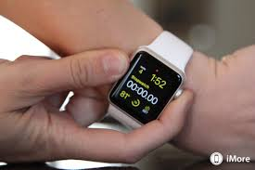
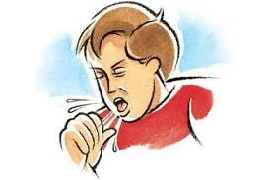
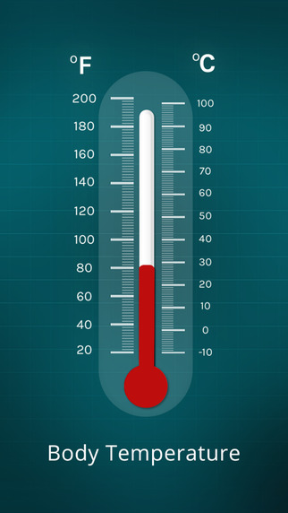

Slide 3
Definition
The Internet of Things (IoT) is the network of physical objects—devices, vehicles, buildings and other items which are embedded with electronics, software, sensors, and network connectivity, which enables these objects to collect and exchange data.

Slide 4
What is the requirement of IoT in this project ?
In a Healing Management System , it works sort of a hospital, hence it senses the tempertaure of a patient & this record is send to the server on doctor.
We aspire that if there is sudden increase in the temperature then it will immediately come in notice of doctor. Doctor can instruct medicine without any delay. This will help in putting a check on patients even if they are out of reach.

Slide 5
Modules of Hardware
1. Transmitter & Receiver using RF Module
2. Mobile Operated Bluetooth Sensor
3. Temperature Measurement

Slide 6
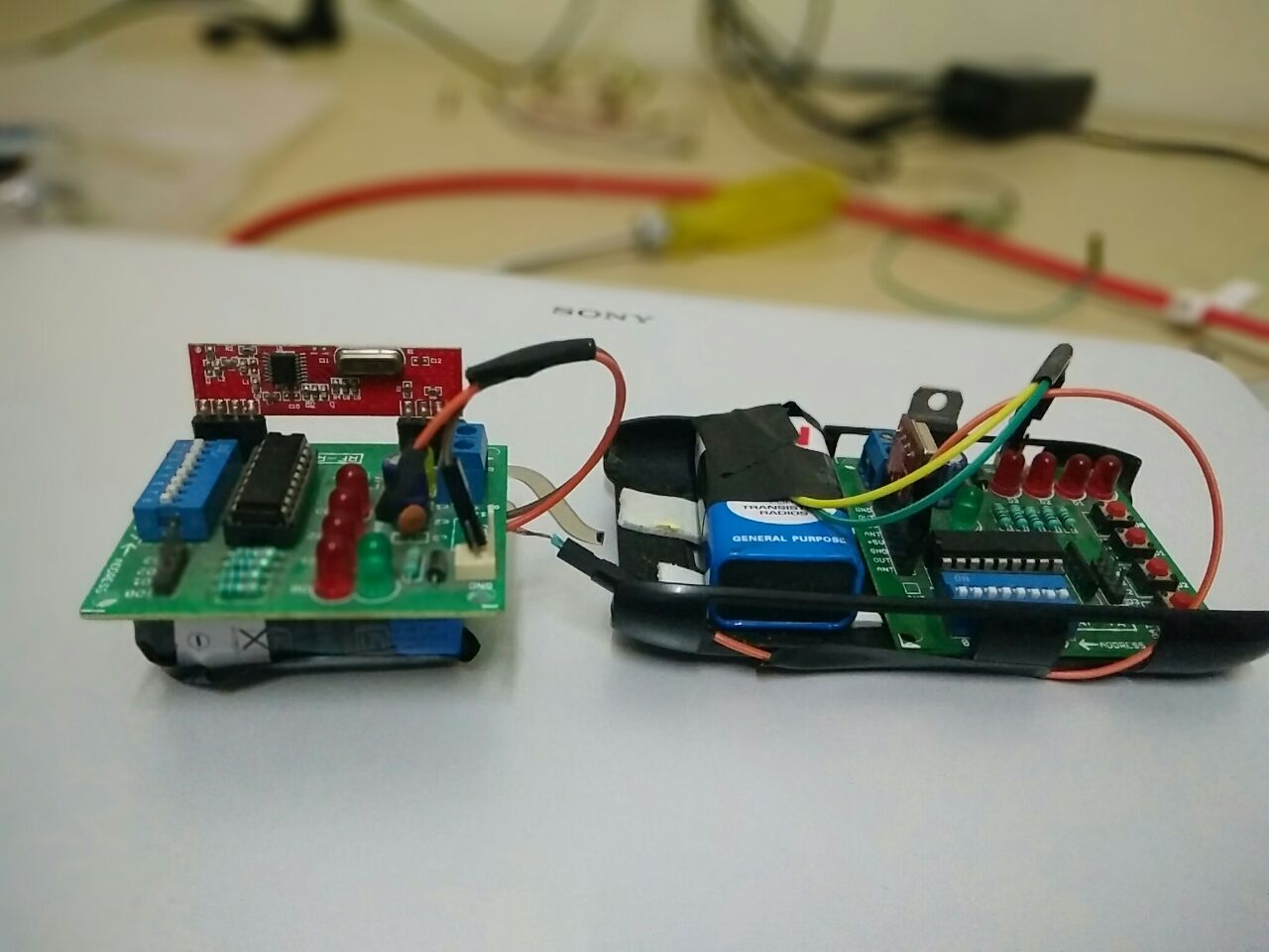
1. Transmitter & Receiver

Slide 7
RF Module connects both modules
Transmitter remains with Patient Side
Receiver remains at Doctor side
Consists of trigger buttons
Helpful in immediate sending of signal in case of strokes
4 leds hence we can have 16 bits
16 varieties of signals can be transmitted

Slide 8
Practical Implementation
00 Everything is fine
01 Fever
10 Pulse Rate High
11 Stroke/ Emergency Situation

Slide 9
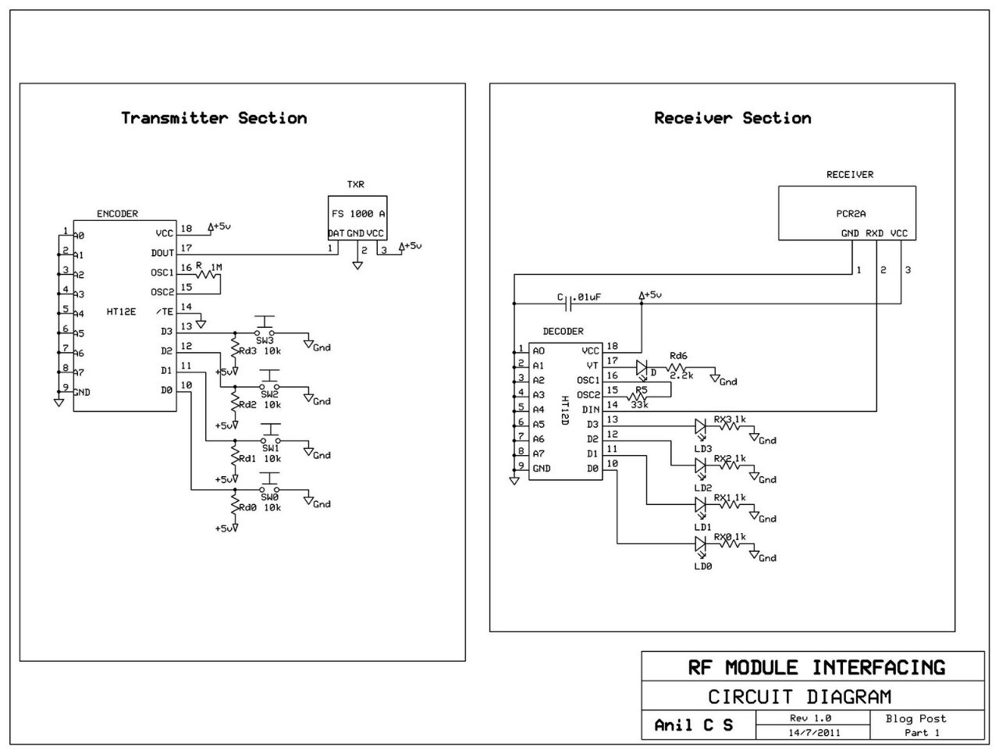

Slide 10
2. Mobile Operated Bluetooth Sensor
Works on Bluetooth sensor
Only cell is required for operation
Sends 2 bits
Bit 0
Bit 1
It can signify at home if something is serious during morning
walk or nearby places

Slide 11
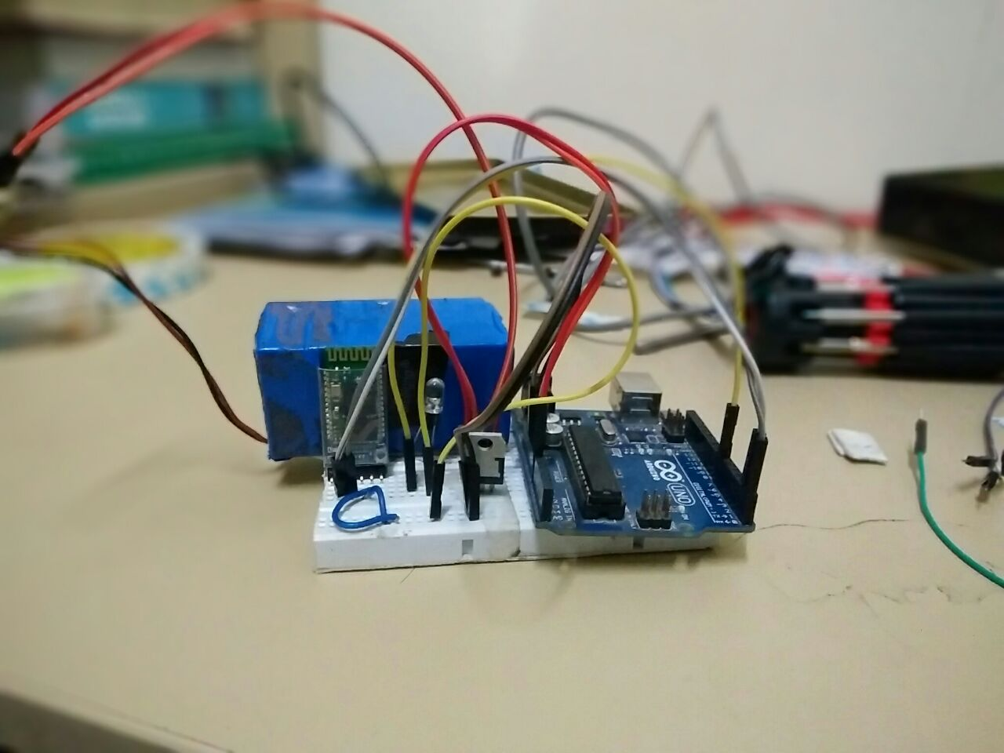
Bluetooth Module Hardware Implementation

Slide 12

Sending signal via Phone

Slide 13
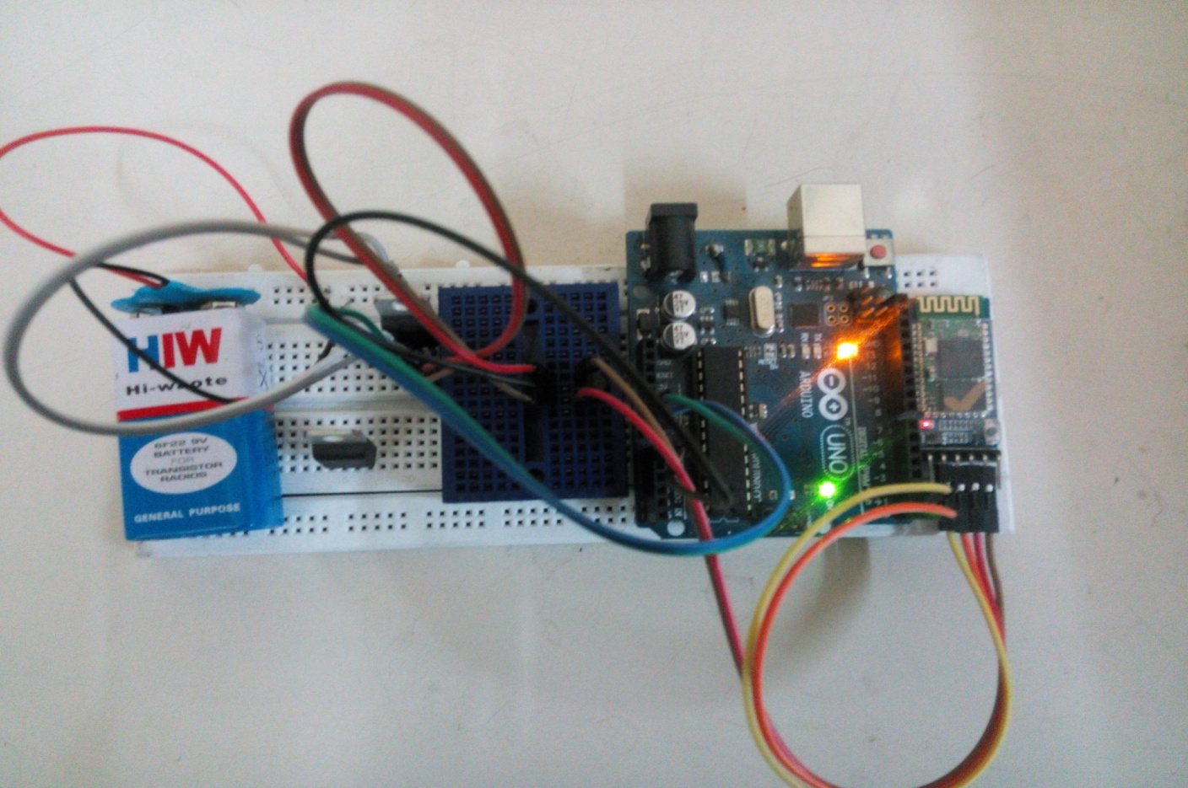
3. Temperature Sensor

Slide 14
How it works ???
Basic Componenets :
Aurdino
Temperature Sensor
Bluetooth Module

Slide 15
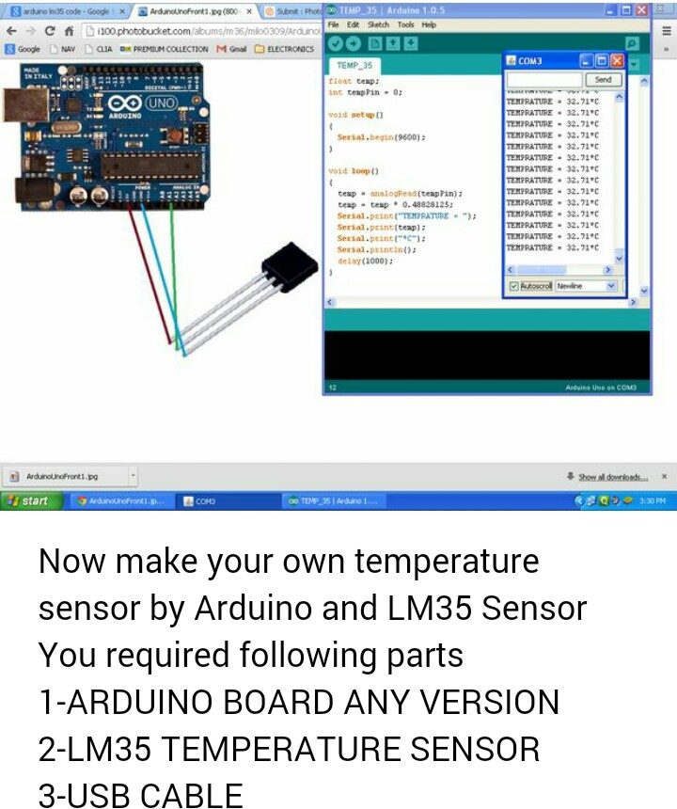

Slide 16
Aurdino
Aurdino provides an interface for the working of temperature sensor. It provides a platform through which we can transfer desired code into the component and can work accordingly.

Slide 17
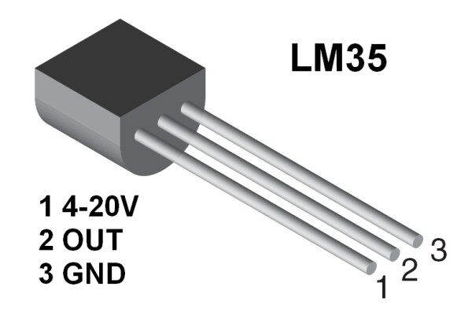
LM 35 Temperature Sensor
It’s a 3 pin tempertaure sensor
It gives readings in 1000
Proper reading in Celcius & Fahrenheits can be achieved using formula in the implemented code

Slide 18
Wireless Bluetooth Module
BlueTooth-HC05-HC06-Modules
BlueTooth-HC05-Modules-How-To Bluetooth is a wireless technology standard for exchanging data over short distances (using short-wavelength UHF radio waves in the ISM band from 2.4 to 2.485 GHz) from fixed and mobile devices, and building personal area networks (PANs). Range is approximately 10 Meters (30 feet).

Slide 19
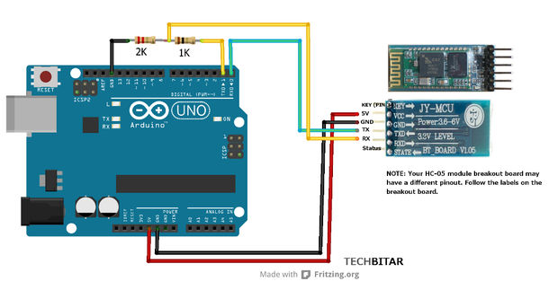

Slide 21
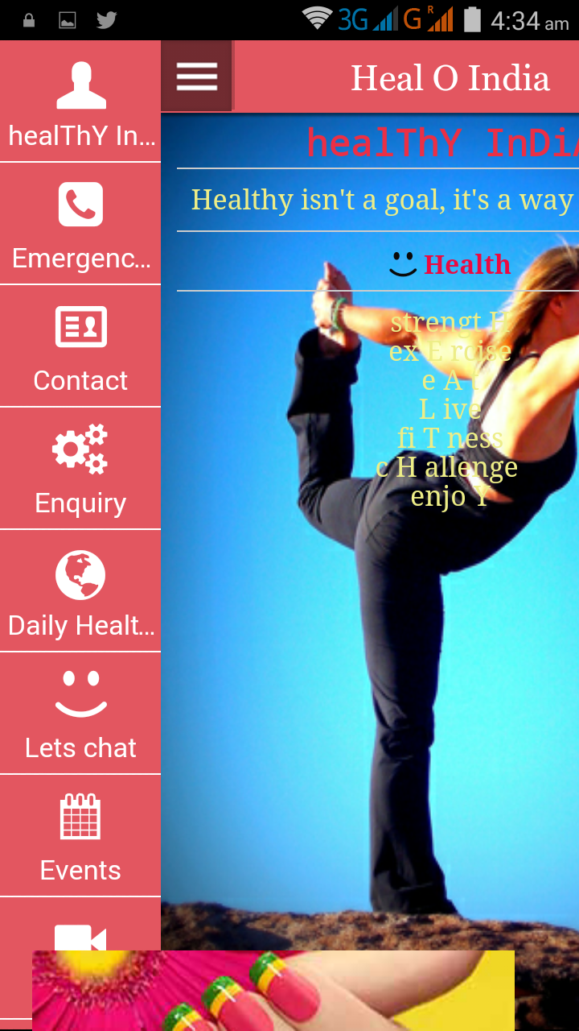
Android App “ Heal O India”

Slide 22
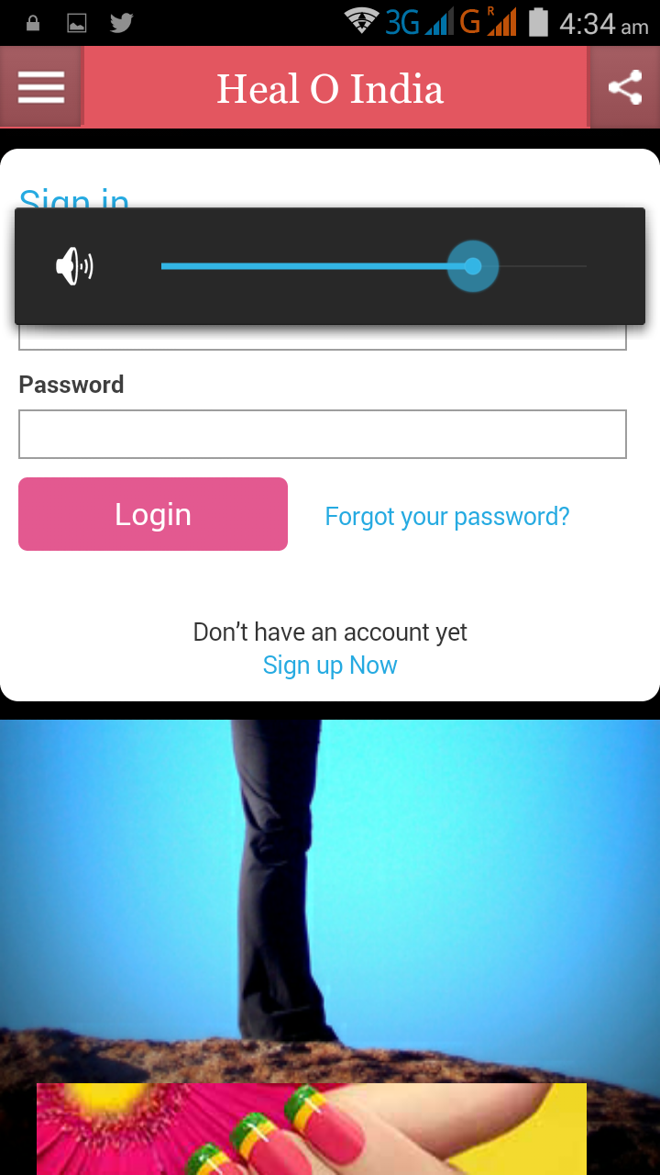
Login page

Slide 23
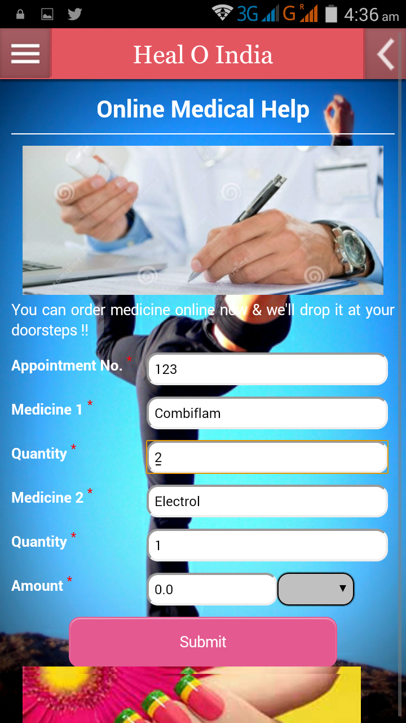
Online Medical Help

Slide 24
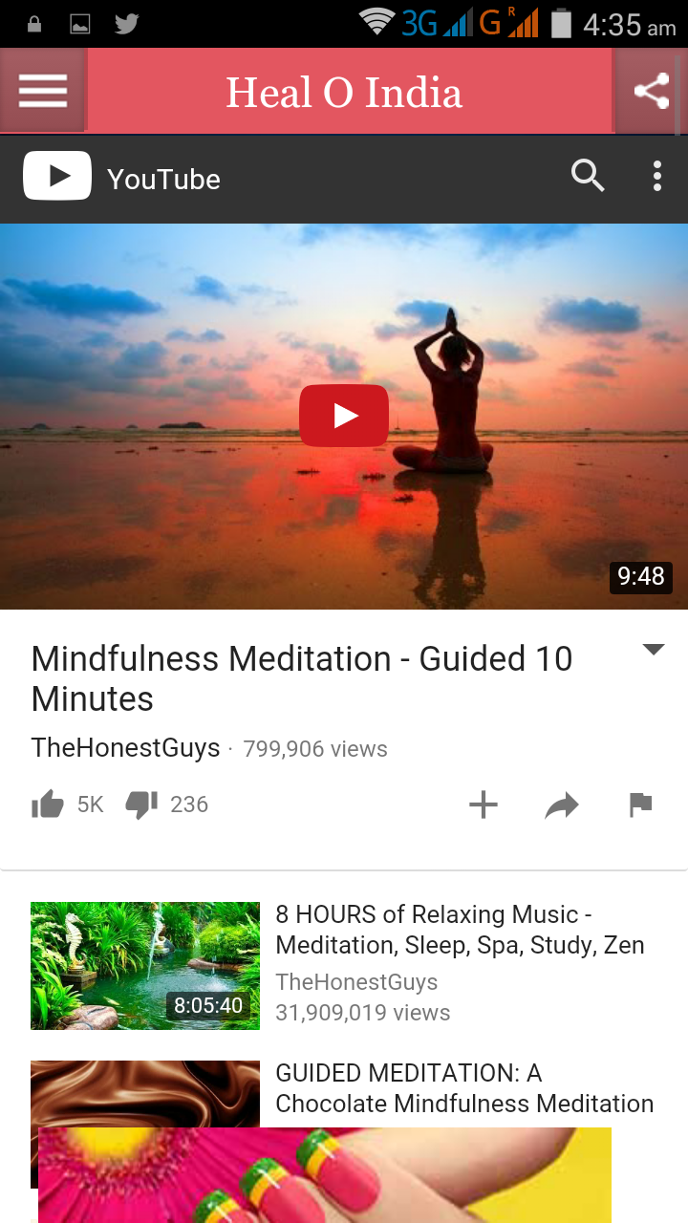
Daily Medical Fitness

